Slide 1
CRYPTOGRAPHY
PRESENTED BY :-
ABHISHEK SHUKLA

Slide 2
INDEX
Introduction
What is Cryptography
Process of cryptography
Types of Cryptography
Features of Cryptography
Conclusion
References

Slide 3
INTRODUCTION
Cryptography derived its name from a Greek word called “Krypto's” which means “Hidden Secrets”.
Cryptography is a type of technology used to protect information and communication, with the help of which the user's data remains secure.

Slide 4
CRYPTOGRAPHY CONT…
It is a method to protect information and communication. This technology uses a type of code to protect information and communication.
Information is protected so that no other person can access its data without the permission of the user.

Slide 5
CIPHERTEXT
Ciphertext is encrypted text transformed from plaintext using an encryption algorithm.
A cipher text is a text in which the receiver of the text converts the text into decode, a process called encryption.

Slide 6
ENCRYPTION
Encryption is the method by which information is converted into secret code that hides the information's true meaning.

Slide 7
Decryption:-
Decryption A process in which encrypted data is converted back into original data.

Slide 8
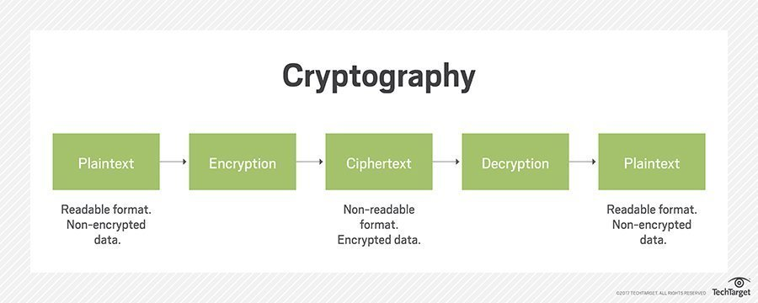
PROCESS

Slide 9
Types of Cryptography
It has three types :-
Asymmetric Key Cryptography
Symmetric Key Cryptography
Hash Function

Slide 10
Features of Cryptography
1- In cryptography, information can be read only by the user who has access to it.
2- In this technique, once the message is sent by the sender to the receiver, that message cannot be modified or edited.
3- In this technique the data sent by the sender to the receiver is stored.
4- In this, the sender cannot deny the receiver after sending the message that he did not send the message, which we also call the condition of non-repudiation.

Slide 11
CONCLUSION
Cryptography is a very good technique for data integrity, authentication and sensitive data protection. It should be used the proper way and proper cryptographic algorithm should be used.

Slide 12
References
www.c-sharpcorner.com
www.ehindistudy.com
www.geeksforgeeks.org

Slide 13

THANK YOU

